Slide 1
Intro to Crypto and Cryptocurrencies
Slides by Arvind Narayanan et al.

Slide 2
How to Store and Use Bitcoins

Slide 3
Simple Local Storage

Slide 4
To spend a Bitcoin, you need to know:
* some info from the public blockchain, and
* the owner’s secret signing key
So it’s all about key management.

Slide 5
How to Store and Use Bitcoins
Secret Keys

Slide 6
Goals
availability: You can spend your coins.
security: Nobody else can spend your coins.
Convenience: Key management should be relativeloy easy.

Slide 7
Simplest approach: store key in a file,
on your computer or phone
Very convenient.
As available as your device.
device lost/wiped ⇒ key lost ⇒ coins lost
As secure as your device.
device compromised ⇒ key leaked ⇒ coins stolen
Notes:
Not adequate for most people. Certainly not for companies/services. So we see lots of methods to try to improve/change the tradeoff between convenience, security, availability. Also privacy.

Slide 8
Wallet software
Keeps track of your coins, provides nice user interface.
Nice trick: use a separate address/key for each coin.
benefits privacy (looks like separate owners)
wallet can do the bookkeeping, user needn’t know

Slide 9
Online Wallets and Exchanges

Slide 10
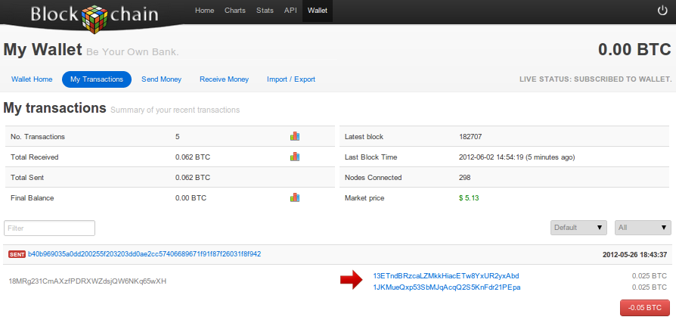
Online wallet
2015 Popular Wallet: Coinbase and Blockchain.info
like a local wallet
but “in the cloud”
runs in your browser
site sends code
site stores keys
you log in to access wallet

Slide 11
Online wallet tradeoffs
convenient: nothing to install, works on multiple devices
but security worries
vulnerable if site is malicious or compromised
ideally, site is run by security professionals

Slide 12
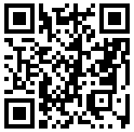
Encoding addresses
Encode as text string: base58 notation
123456789ABCDEFGHJKLMNPQRSTUVWXYZabcdefghijkmnopqrstuvwxyz
or use QR code

Slide 13
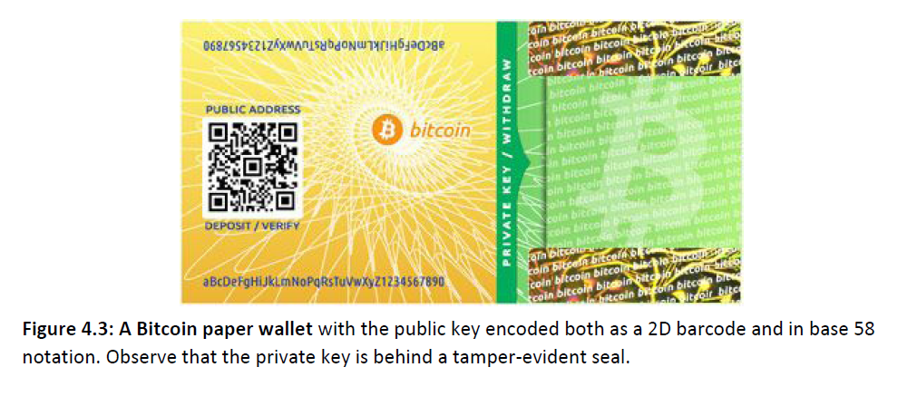

Slide 14
Bank-like services
you give the bank money (a “deposit”)
bank promises to pay you back later, on demand
bank doesn’t actually keep your money in the back room
typically, bank invests the money
keeps some around to meet withdrawals (“fractional reserve”)

Slide 15
Bitcoin Exchanges
accept deposits of Bitcoins and fiat currency ($, €, …)
promise to pay back on demand
lets customers:
make and receive Bitcoin payments
buy/sell Bitcoins for fiat currency
typically, match up BTC buyer with BTC seller

Slide 16
What happens when you buy BTC
suppose my account at Exchange holds $5000 + 3 BTC
I use Exchange to buy 2 BTC for $580 each
result: my account holds $3840 + 5 BTC
note: no BTC transaction appears on the blockchain
only effect: Exchange is making a different promise now

Slide 17
Exchanges: Pros and Cons
pro: connects BTC economy to fiat currency economy
easy to transfer value back and forth
con: risk
same kinds of risks as banks
Risk of Bank Run
Bank Owner running Fraud Scheme
Security Attack- Hacking the stored secrets

Slide 18
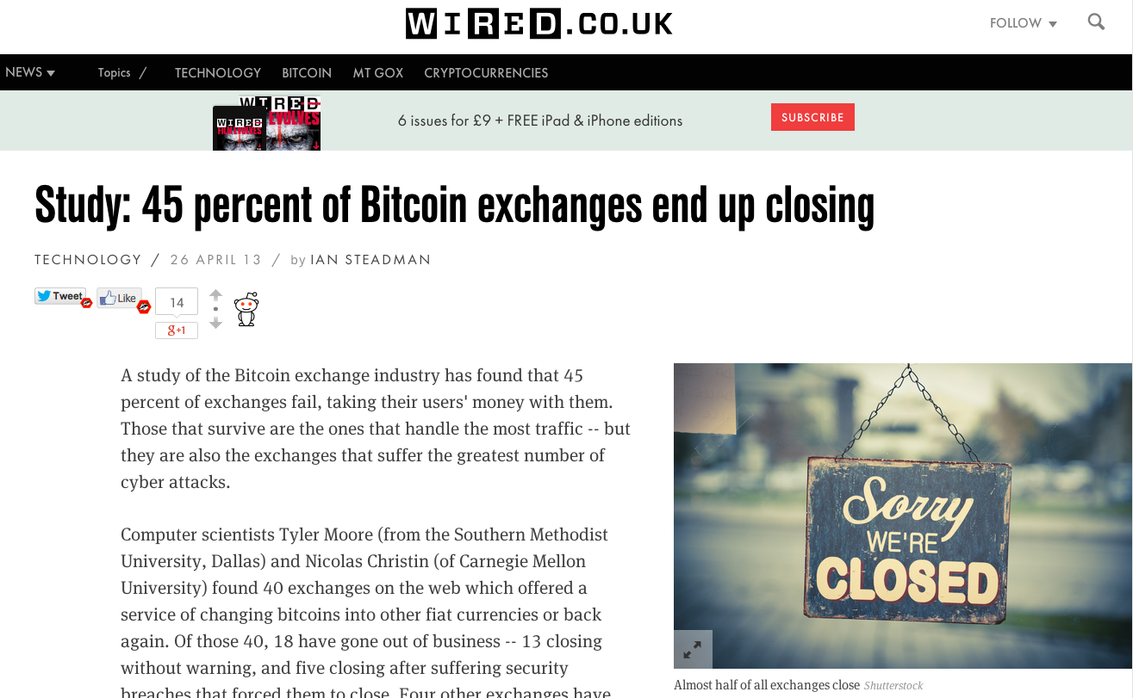

Slide 19
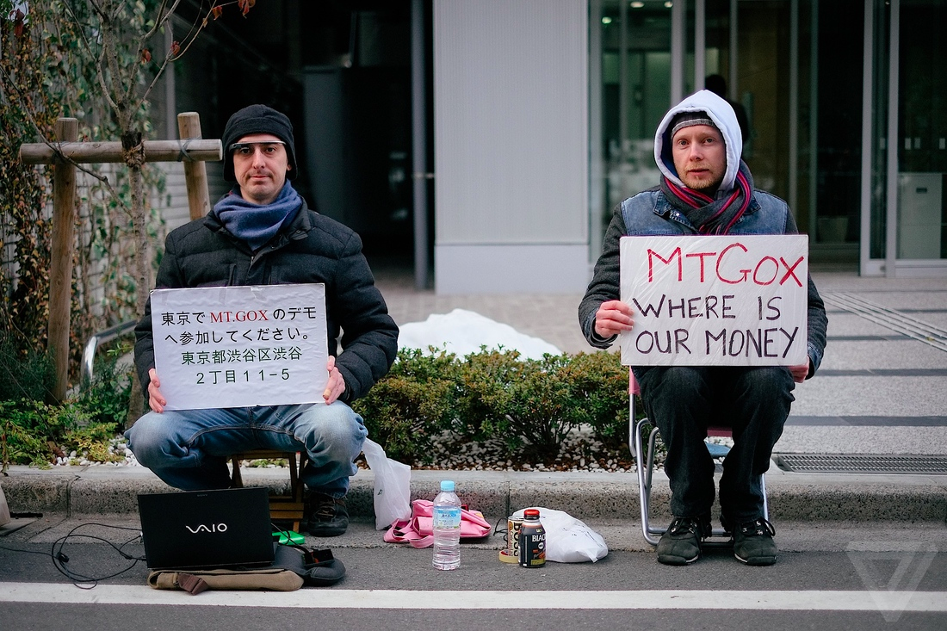

Slide 20
Bank Regulation
for traditional banks, government typically:
imposes minimum reserve requirements
must hold some fraction of deposits in reserve
regulates behavior, investments
insures depositors against losses
acts as lender of last resort
Notes:
Reserve requirement in the U.S. is typically 3-10%.

Slide 21
Proof of Reserve
Bitcoin exchange can prove it has fractional reserve.
fraction can be 100%
Prove how much reserve you’re holding:
publish valid payment-to-self of that amount
sign a challenge string with the same private key
Prove how many demand deposits you hold: ...

Slide 22
Merkle tree with subtree totals
each hashpointer includes total value in its subtree
H( ) H( )
H( ) H( )
H( ) H( )
H( ) H( )
H( ) H( )
H( ) H( )
H( ) H( )
user1
acct
user2
acct
user3
acct
user4
acct
user5
acct
user6
acct
user7
acct
user8
acct

Slide 23
Checking that you’re represented in the tree
show O(log n) items
H( ) H( )
H( ) H( )
H( ) H( )
your
acct

Slide 24
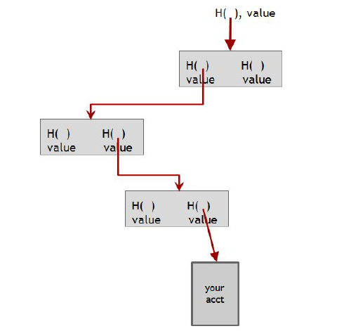

Slide 25
Proof of Reserve
Prove that you have at least X amount of reserve currency
Prove that customers have at most Y amount deposited
So reserve fraction ≥ X / Y

Slide 26
Payment Services

Slide 27
Scenario: merchant accepts BTC
customer wants: to pay with Bitcoin
merchant wants:
* to receive dollars
* simple deployment
* low risk (tech risk, security risk, exchange rate risk)

Slide 28
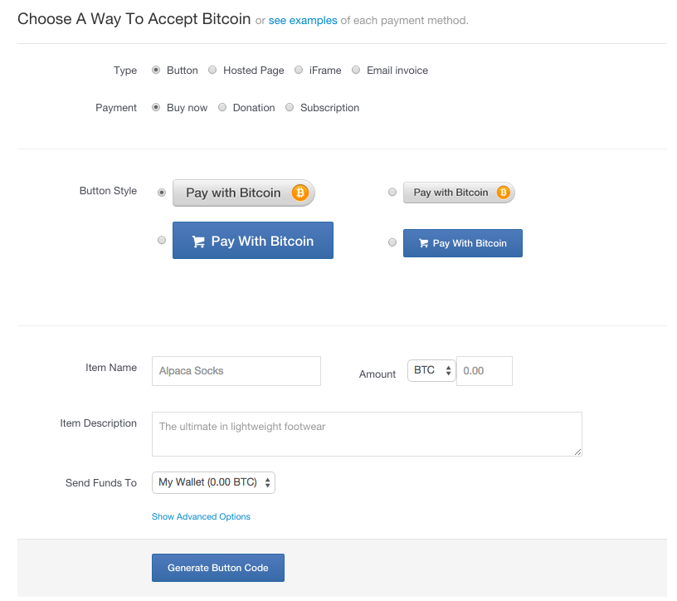
HTML for
payment button

Slide 29

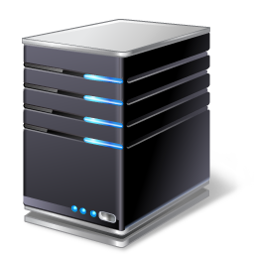


payment
service
merchant
(5) confirm <transID, amount>
(4) redirect
(3) payment interaction
(4b) ok so far
(1) Pay with BTC button <transID, amount>
(2) clicked <transID, amount>
user

Slide 30
End result
customer: pays Bitcoins
merchant: gets dollars, minus a small percentage
payment service:
gets Bitcoins
pays dollars (keeps small percentage)
absorbs risk: security, exchange rate
needs to exchange Bitcoins for dollars, in volume

Slide 31
Currency Exchange Markets

Slide 32
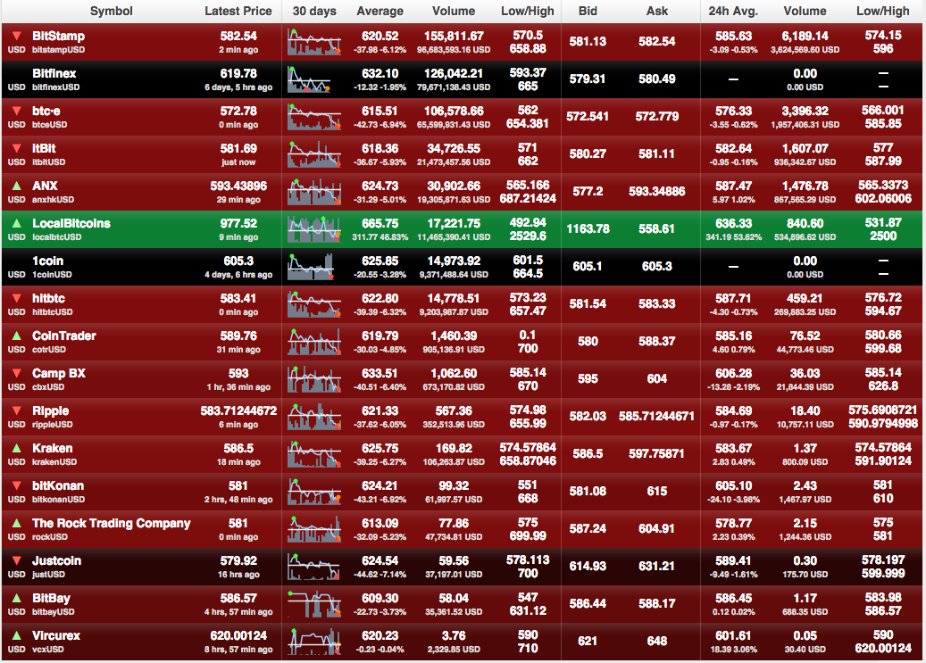
http://bitcoincharts.com/markets

Slide 33
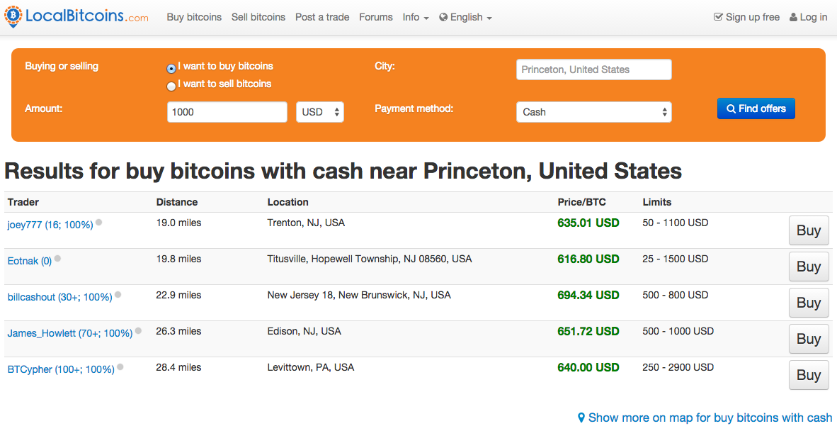

Slide 34
Basic market dynamics
market matches buyer and seller
large, liquid market reaches a consensus price
price set by supply (of BTC) and demand (for BTC)

Slide 35
Supply of Bitcoins
supply = coins in circulation (+ demand deposits?)
coins in circulation: fixed number, currently ~13.1 million
When to include demand deposits?
When they can actually be sold in the market.

Slide 36
Demand for Bitcoins
BTC demanded to mediate fiat-currency transactions
Alice buys BTC for $
Alice sends BTC to Bob
Bob sells BTC for $
BTC demanded as an investment
if the market thinks demand will go up in future
BTC “out of circulation” during this time

Slide 37
Simple model of transaction-demand
T = total transaction value mediated via BTC ($ / sec)
D = duration that BTC is needed by a transaction (sec)
S = supply of BTC (not including BTC held as long-term investments)
S
D
Bitcoins become available per second
Equilibrium:
P =
T
P
TD
Bitcoins needed per second
S

Slide 38
Hot and Cold Storage

Slide 39
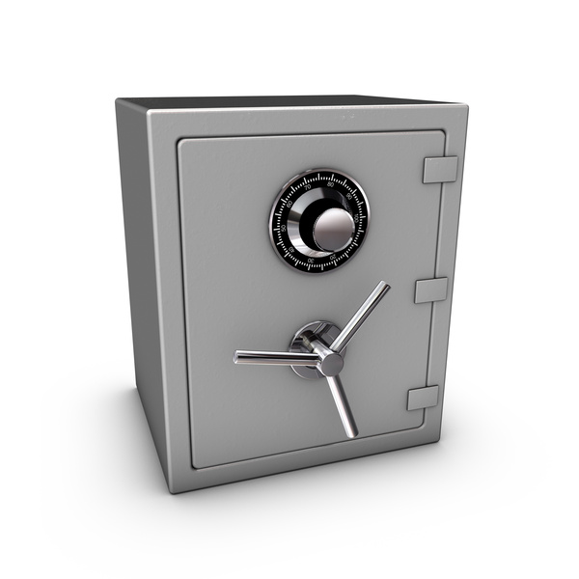
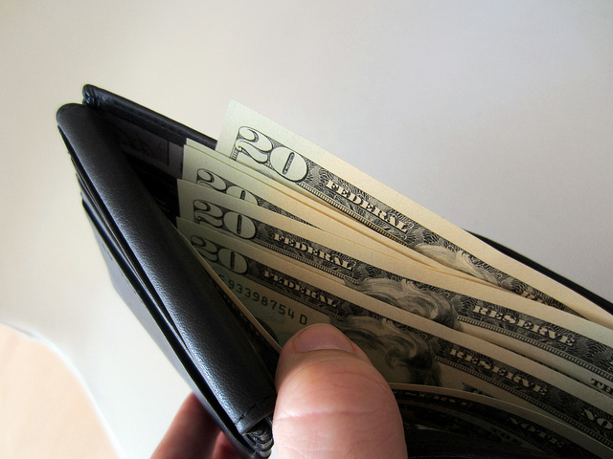
Hot storage
Cold storage
online
offline
convenient but risky
archival but safer
separate keys

Slide 40
Hot storage
Cold storage
online
hot secret key(s)
payments
cold address(es)
offline

Slide 41
Problem:
Want to use a new address (and key) for each coin sent to cold
But how can hot wallet learn new addresses if cold wallet is offline?
Awkward solution:
Generate a big batch of addresses/keys, transfer to hot beforehand
Better solution:
Hierarchical wallet

Slide 42
Regular key generation:
address
generateKey
private key

Slide 43
Hierarchical key generation:
i
doesn’t leak keys
address
gen info
i^{th}
address
genAddr
generateKeysHier
private key
gen info
i^{th}
key
genKey
i

Slide 44
hot side
i
address
gen info
i^{th}
address
genAddr
generateKeysHier
private key
gen info
i^{th}
key
genKey
cold side
i

Slide 45
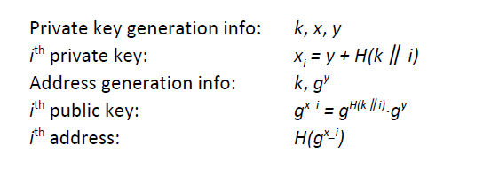
ECDSA hierarchical key generation Scheme

Slide 46
How to store cold info
(1) Info stored in device, device locked in a safe
(2) “Brain wallet”
encrypt info under passphrase that user remembers
(3) Paper wallet
print info on paper,
lock up the paper
(4) In “tamperproof” device
device will sign things for you, but won’t divulge keys
Notes:
Highlight activity of stealing these

Slide 47
Splitting and Sharing Keys

Slide 48
Secret sharing
Idea: split secret into N pieces, such that
given any K pieces, can reconstruct the secret
given fewer than K pieces, don’t learn anything
Example: N=2, K=2
P = a large prime
S = secret in [0, P)
R = random in [0, P)
split:
X₁ = (S+R) mod P X₂ = (S+2R) mod P
reconstruct:
(2X₁-X₂) mod P = S

Slide 49
y
random slope R
(4, S+4R)
(2, S+2R)
(3, S+3R)
given any two points,
can interpolate and find S
(0, S)
(1, S+R)
(do arithmetic modulo large prime P)
x

Slide 50
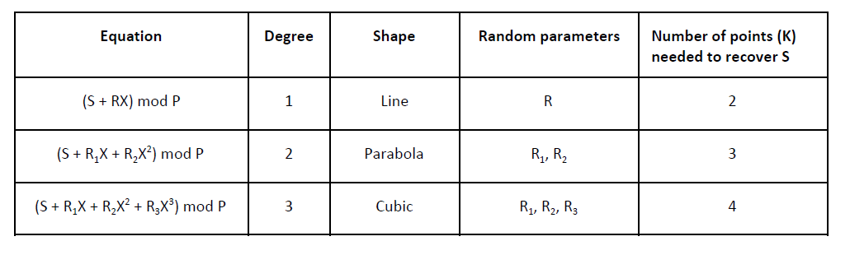
Secret sharing

Slide 51
Secret sharing
Equation | Random parameters | Points needed to recover S
(S + RX) mod P | R | 2
(S + R₁X + R₂X²) mod P | R₁, R₂ | 3
(S + R₁X + R₂X² + R₃X³) mod P | R₁, R₂, R₃ | 4
etc.
support K-out-of-N splitting, for any K, N

Slide 52
Secret sharing
Good: Store shares separately, adversary must
compromise several shares to get the key.
Bad: To sign, need to bring shares together,
reconstruct the key. ⇐ vulnerable

Slide 53
Multi-sig
Recall multi-sig.
Lets you keep shares apart, approve transaction without reconstructing key at any point.

Slide 54
Example
Andrew, Arvind, Ed, and Joseph are co-workers.
Their company has lots of Bitcoins.
Each of the four generates a key-pair,
puts secret key in a safe, private, offline place.
The company’s cold-stored coins use multi-sig, so that three of the four keys must sign to release a coin.

